Slide 1

Course:
Contemporary Employment Relations
Course Code:MHR 552

Slide 2
House keeping
Name
Profession
Place of work
Hobby

Slide 3
~we know in part~

Slide 4
Assessment
Class Participation (5%)
Group work (15%)
Assignment (20%)
End of Semester Exams (60%)

Slide 5
GWQs
Explain the concept of “” with regards to employment in Ghana.
  What are the importance of this phenomenon ?
  Give your opinion regarding the possible effects of its application in the Ghanaian context
  (15 Marks)

Slide 6
Why this course?
Employee-employer relationship is vital to the success of any company or business (Kar, Sharma, & Borah, 2011).
Provide greater perspectives and insight into employment relations practices
Contributes to knowledge about ER

Slide 7
Learning Outcomes
After studying this course the student should;
Understand and critically evaluate competing approaches that contextualise development in employment relations
Understand and apply contemporary labour market trends and data specifically examining exploitative relationships;
Understand the main sources of employment relations legislation and developments in alternative dispute resolution;
Demonstrate and apply knowledge of ethical and legal principles and practices in analysing and responding to business issues;
Understand and critically evaluate the role of the parties that affect the management of employment relationships;
Understand evaluate contemporary developments in employee voice.

Slide 8
History of IR/ER

Slide 9
History of Employment Relations
Long history of industrial unrest
profit maximization suppression of labour
Friction between actors
Grew out of the need to protect the common interest of workers
Classical Industrial Relations Theory (1890s to 1980s) organized labor furthered its goals—through collective bargaining, legal enactment, and mutual insurance.
.

Slide 10
Cont’d
The neo-classical theorists give attention to how labour markets operate and how market forces work to determine wages and as well as the acquisition and use of labour, which reflects the behaviour of profit-maximising entrepreneurs within highly competitive market structures
Post-Transformation Employment Relations Theory (1980s to early 2000s)
This shift in focus is reflected in changing nomenclature in the field from ‘‘industrial relations’’ to ‘‘labor and employment relations,’’ along with aspirations to develop a more generally applicable body of employment relations theory for the present era.

Slide 11
Brief History ….
Let's take a brief look at history:
For many years, ther have been some form of bargain and negotiation around the relationship between employers and their employees.
As we moved into the 1800s Industrial Revolution, large companies began to employ vast numbers of people, craftsmen and lower-skilled workers in mills and forges and on highly repetitive production lines in factories.
The move from farming to factories and city living gave us the earliest forms of the capitalist system we now know.
Wealth acquisition came from industrial strength, not the privilege of birth into the upper classes.

Slide 12
Cont’d-conditions of work
With pressures to keep costs low, production and quality high, plus make profits, industrialists began to push people with longer hours, shortcuts on safety, and disregard for worker welfare
People would be exhausted, ill, dismissed, or even died because of poor conditions in those working environments.
And so collective worker responses were needed to fight injustice through forms of protest or the ultimate withdrawal of labor. We'd now refer to them as walkouts or strikes.

Slide 13
Cont’d-legal framework
Employment law followed with pressure put on governments to legislate, which continues to this day.
Workplace wrongdoing, such as employers discriminating against women or older workers in promotion decisions, would become punishable by law, with the state now able to prosecute businesses and owners whilst giving worker representatives legal force to back their claims of unfair treatment and conditions.
This led the way to the development of initially industrial relations, what we now know as employee relations
Employment legislation is aimed at giving workers protection,
avoiding union disputes.

Slide 14
Cont’d-unionism
The 20th-century workplace history describes a range of industrial disputes covering working time regulations to fair pay and benefits.
The 1970s and 1980s were peak unionization period, but this changed in the 1990s with a significant decrease in union power.
The decrease of union power continues to now.
In present times, large scale disputes are rare and often resolved through mediation and someone taking an independent view.
So where has all this led us?

Slide 15
Cont’d-future of work
The future for worker representation and employee relations is becoming a more complex one, with digital and robotic automation of work, new forms of worker status like self-employed agents, and a keen interest in good organizations.
Employee relations will be an even more interesting area of the elements of a collaborative organization.
A new form of employee relations may be upon us.
What in your opinion is the future of employment ?

Slide 16
Theories and perspective

Slide 17
Introduction to theories of ER
What is employment relations?
?

Slide 18
Introduction
The scenario of employment relations is perceived differently by different people.
For some, employment relations is related to class conflict, others perceive it in terms of mutual co-operation and still others understand it in terms of competing interests of various groups.
HR managers are expected to understand these varying approaches because they provide the theoretical underpinnings for much of the role of HRM.
The three popular approaches to Industrial Relations are (Unitary,Pluralistic, and Marxist approach)

Slide 19
Definition
“A field of study that deals with the formal and informal relationship between an organisation and its employees. This embraces the potentially wide range of interactions and processes by which the parties to the relationship adjust to the needs, wants and expectations of each other in the employment situation.” Rollinson and Dundon (2007)
Defined as institutions involved in governing the employment relationship, the people and organisations that make and administer them, and the rule making processes that are involved , together with their economic and social outcomes.
According to Omodan et al. (2020), human relations theory is meant to manipulate workplace relations in ways that enable employees to feel personal satisfaction with being involved with the organization

Slide 20
Three theoretical approach
Frame of reference
.
Unitary Approach
Pluralistic Approach
Marxist Approach

Slide 21
Definitions of frame of reference
Unitarist
Management and employees share the same concerns and itis therefore in their interests to cooperate ‘ the principle of mutuality’(Walton, 1985)
Pluralist
Interests of employees will not necessarily coincide with their employers and that the unitarist view is naïve.
Radical/Marxist
Unequal distribution of power between employer and employee (treated as a commodity)

Slide 22
Unitarism
The concept of unitarism is predominantly associated with Alan Fox but the concept of unitarism appeared in the works of Ross (1958), who associated the theory with being employer centered.
This perspective perceives employing organisations as peopled by individuals and groups that have common interests, objectives and values, and that are harmonious and integrated.
This theory assumes that the management and workforce are working together for the good of the organization (Kaufman, 2004). It perceives the organization as being a coherent team united by a common purpose.

Slide 23
Cont’d
Management’s right to manage is legitimate and rational.
Management (representing the organisation and the interests of capital) should be the single focus of employee loyalty as well as the sole source of legitimate authority.
This perspective tends to be associated with, and is often promoted by, management since it supports management’s interests.
Frequently this perspective has been characterised as the ‘one big happy family’ approach.
The unitarist employment relationship, therefore, is seen as a long-term partnership between employees and employers with common interests.

Slide 24
Cont’d
Conflict between labour and management is viewed as being both unnecessary and avoidable.
Where conflict does occur it is argued that this it occurs because of poor communication, because the parties to the relationship lack understanding of the extent to which their interests are coincident.
Managements holding this perspective will often try to persuade their employees that they do not need a trade union to represent them and that management will prioritise their needs.
Examples of companies in which this attitude has dominated would certainly include big names such as Marks & Spencer, IBM and Hewlett-Packard.

Slide 25
Pluralist
This perspective assumes that employing organisations are made up of individuals and groups with different interests, values and objectives.
Each group is likely to develop its own leadership and source of loyalty. The various interests and objectives of one group are likely to conflict with those of others and, while this will.
Conflict are common within this organisations between different groups of employees and between different management functions as well as between labour and capital.
Management has a very different role in is now upon securing the agreement of the other interests to decisions.

Slide 26
Cont’d
Conflict is resolved via mechanisms that emphasize the achievement of consensus, representation and participation from the various interests concerned.
Collective bargaining is one possible mechanism and, in this context, the formation of trade unions is a realistic and rational response on the part of the labour.
Collective strength, provide employees with a counter to the otherwise unfettered power of the employer. The absence of collective organisation on the part of the workforce leaves it weak and open to exploitation.
Pluralistic models of employment relations were based on a specific context, one in which there was a clear definition of the main actors of employment relations—unions, employers, and governments or states—pursuing their interests through more or less stable sets of formal institutions

Slide 27
Radical/Marxist
From this perspective organisations employing labour do so only in order to exploit it.
The purpose of capitalism, according to Marxists, is to make surplus value/profit from the employment of resources in the labour process, and it is in this sense that it is argued that labour is exploited, since this surplus value accumulates to capital.
In Marxist and related perspectives, employers are seen as the owners and controllers of the means of production which provides both the incentive and the means to continually push for greater profits at the expense of workers.

Slide 28
Cont’d
Unlike unitarism, it recognises that employees have different interests to those of the employer, and unlike pluralism this perspective on the employment relationship permits concurrent conflict and consensus
The labour process
It is the term used to describe the process whereby labour is added to capital and technology to produce goods and services that are then exchanged for others. It is the process through which labour potential is converted into actual.

Slide 29
Features of the Employment Relations
Employment relations seeks to secure the highest possible level of mutual understanding, good-will and cooperation between several interests (stakeholders) which take part in the process of production and service deliver, It is dependent on:
  Fair dealings
  Trust (mutual confidence)
  Good working conditions
  Organisational climate
  Cooperation

Slide 30

Parties/Actors in the relationship
Anybody who enters into an arrangement with another person for the purposes of rendering some service to the person for defined remuneration creates an employment relation.
An "employer" means any person who employs a worker under a contract of employment;
A "worker" means a person employed under a contract of employment whether on a continuous, part-time, temporary or casual basis;

Slide 31
Employment relationship-contract
It views the relationship between employer and employee as a contract.
It consists of a promise to work (or to be available for work) in return for which payment is promised.
Since there has been a free exchange of promises, the two parties have reciprocal, but different rights and obligations. [Sec 8-11, Labour Act, 2003 (Act 651)].
Contracts can be explicit or implicit, economic, psychological, or social.

Slide 32
Cont’d
Employers and employees should be able to enter into any explicit or implicit contract.
A mutually-agreeable terms and conditions of employment, including compensation, hours, duration of employment, job duties, and the like.
In the interests of both economic optimization and individual freedom, employers and employees should likewise be able to end these arrangements when conditions or preferences change, or if a better deal comes along (Epstein, 1984).

Slide 33
Right of Employer and Employee
Both employees and employers have legal rights.
An employer’s rights are the employee’s responsibilities (and vice versa).
Some legal rights are statutory. This means everyone has them.
Some legal rights are contractual. These are rights stated in the contract of employment.
The employer must:
Do what the contract of employment says. These are the express terms (hours, holidays etc).
Comply with the implied terms – so obvious they are not stated (honesty, working towards the objectives of the organisation, etc).
Comply with all health and safety rules.

Slide 34
Cont’d
Employee rights, relate to:
The employer keeping to the contract of employment
Working in a healthy and safe environment
Being appropriately trained
Joining a trade union or staff association
Being allowed access to own personal employee record.

Slide 35
Psychological Contract
Psychological contracts focuses on perceived mutual obligations regarding the broad manner in which employees are treated and encompass dimensions such as fairness and respect
(Robinson and Rousseau, 1994).
The main assumptions are that:
Employees will be treated fairly and honestly;
The relationship will be characterised by a concern for equity and justice and this will require the communication of sufficient information about changes and developments.

Slide 36
Cont’d
Employee loyalty to the employer will be reciprocated with a degree of employment and job security.
Employees’ input will be recognised and valued by the employer.
The successful conclusion of both processes is the creation of a legally binding agreement between the employer and the employee, setting out the rights, obligations and expectations of both parties (Armstrong, 2006).
Contract: contractual relationship which is derived from a series of assumptions on the part of employer and employee about the nature of their relationship.

Slide 37
Employment context
Lets look at key outline of recruitment and selection processes, highlighting major issues to consider.
Recruitment is the process of seeking applicant for positions within a business - on either a general basis or targeted to address particular vacancies. Potential applicants may be interested, but there is no mutual obligation between the possible employee and the employer concerned.
Selection takes the next step, where the employer makes a choice between two or more interested applicants.
  However, it is often not appreciated how applicants also select their future employer, making conscious and unconscious decisions as to how much further they wish to pursue their original employment enquiry (Torrington, Hall, Taylor & Atkinson, 2014).

Slide 38
Cont’d
Any successful recruitment process must provide businesses with a pool of suitable candidates for any vacant positions.
The methodologies employed must be fair (and can be shown to be so) whilst also complying with the relevant legal and regulatory frameworks surrounding employment
Recruitment activities must contribute to corporate goals, reflect organisational brand, image and values whilst also being efficient and cost effective (Foot & Hook, 2008).

Slide 39
Forms of employment
Employment can be grouped into three main categories depending on the period of payment.
Three basic types of contracts exist:
Permanent employment ( Continuous until 60 yrs)
Casual Employment (seasonal and intermittent work for not more than six months) and
Temporary employment (project based with fixed duration)
Diversity in recruitment

Slide 40

Labour market
Buyers and sellers of labor or other commodities simply search for transactions that maximize their utility. Labor is seen as a commodity not different from other productive resources.

Slide 41
Cont’d
The structure of the labour market - what jobs exist, how many, which sectors
The way the labour market functions - how people get into jobs & move between employers
Labor markets are generally seen as perfectly competitive and therefore the primary driver of the employment relationship
Wages and salaries, benefits, and other terms and conditions of employment are not set by individual employees, employers, or states, but by the invisible hand of the labor market

Slide 42
Cont’d
The most prevalent access mechanism for labor‐market entry in Ghana is patron‐client relationships, or what was termed the “moral economy” in the academic literature of the 1980s and 1990s (Hyden 2006; Lemarchand 1989)

Slide 43
Employment relation

Slide 44
Managers
In Mintzberg’s seminal study of managers and their jobs, he found the majority of them clustered around three core management roles.
Three of a manager’s roles arise directly from formal authority and involve basic interpersonal relationships.
First is the figurehead role, as the head of an organizational unit, every manager must perform some ceremonial duties.
Managers are required to interact with a substantial number of people in the course of their day to day work.
They host receptions; take clients and customers to dinner; meet with business prospects and partners; conduct hiring and performance interviews; and form alliances, friendships, and personal relationships with many others.

Slide 45
Cont’d
Numerous studies have shown that such relationships are the richest source of information for managers because of their immediate and personal nature.
Managers are also responsible for the work of the people in their unit, and their actions in this regard are directly related to their role as a leader.
The influence of managers is most clearly seen, according to Mintzberg, in the leader role. Formal authority vests them with great potential power. Leadership determines, in large part, how much power they will realize.

Slide 46
Employment process

Slide 47
Employee involvement
Employee involvement has become a convenient catchall term to cover a variety of techniques (Cotton, 1993: 3, 14).
For instance, it encompasses such popular ideas as employee participation or participative management, empowerment, workplace democracy, employee ownership and many more.
Employee involvement is defined as a participative process that uses the entire capacity of employees and is designed to encourage increased commitment to the organisation’s success (Pierce & Furo, 1990: 32).

Slide 48
Forms of participation
Finnemore & Van Rensburg defines it as a process of interaction whereby employees directly or indirectly through their representatives are able to influence decision-making which affects their power, status, remuneration and working conditions.
Employee involvement may take many forms. It may involve direct involvement of employees or indirect participation of lower-level workers in decision making and the conduct of their jobs, with goal of improving performance (Daft 1991: 465).

Slide 49
Cont’d
The processes of direct involvement include information sharing, participation in teams of various forms, financial participation, and exercising workers control through co- operatives.
The processes of indirect participation by means of an elected representative include works councils and processes of consultation and joint decision-making over workplace issues, collective bargaining over wages and conditions of services.
It also includes corporate decision-making by board of directors or participation in policy development on regional/national socio-economic

Slide 50
Why employee involvement
Because it is assumed that EI initiatives will encourage employees to be more content and satisfied in their work;
it is assumed that this will yield employee commitment, and satisfied and committed employees are harder working etc

Slide 51
Employee Commitment
Commitment refers to employees positively identifying with and sharing the values and purposes of the organisation.
It describes the kind of attachment we tend to associate with membership in public-sector service, rather than with membership of the more common private-sector and profit-making employing organisations.
Commitment is portrayed as an internalised belief leading to constructive proactivity by employees; it leads to employees ‘going one step

Slide 52
Forms of commitment
Attitudinal commitment is the form depicted above and which would be compatible with Etzioni’s moral involvement: commitment in terms of a sharing of values and attitudes, a psychological bond to an organisation, an affective attachment.
Behavioural commitment is demonstrated by a willingness to exert effort beyond the requirements of contract and/or by a desire to remain a member of an organisation.

Slide 53
Management styles
Within the context of the employee relationship ‘management’ refers to the activities of managers acting as agents for the employer, but ‘management’ can also be used as a general term describing the body of people undertaking these activities
Matlay (1999) in his article ‘Employee relations in small firms – a micro business perspective’ mentioned management styles as factor affecting interpersonal relationships in organization
There are various management style at the disposal of every manager

Slide 54
Types of leadership styles
Autocratic Authoritarian and dictatorial leaders show lower employee satisfaction
Democratic leaders encourage friendship, respect and warmth relationship among the employees
Laissez faire: there are no specific leader in this approach to management. Employees have freedom to use their discretion in maximizing profit.

Slide 55
Employment process

Slide 56
Collective Bargaining
Method of determining terms and conditions of employment /regulating the employment relationship -utilises the process of negotiation between employers and employees -intended to result in an agreement applicable across group of employees Salamon (1998:305).
Collective bargaining is the process in which working people, through their unions, negotiate contracts with their employers to determine their terms of employment.

Slide 57
Cont’d
Individualism, on the other hand, is defined as a single human being or phenomenon as distinguished from a group of people in employment relations, for instance.
It is also defined as the ethos which emphasizes the autonomy of the individual as against the community or social group.

Slide 58
Bargaining styles
Two broad bargaining styles
Distributive bargaining – best described as win–lose / zero sum bargaining. (Winner takes all).
One party’s loss is the other party’s gain
– most true about adversarial bargaining; conflict is commonplace
Power differentials between parties to employment relationship and shifts in the power balances underscored through distributive bargaining
Distributive bargaining characterised by issues such as terms and conditions of employment, wages, overtime etc

Slide 59
Bargaining styles
Integrative bargaining – opposite of distributive bargaining stresses a win-win outcome / produces joint gains
Relies more on principles of resolution, compromise, and consensus seeking
(Bendix, 1996:264) suggestions for effective integrative bargaining:
Mutual identification and recognition of problems
Exchange of and access to all information required to facilitate effective bargaining
Commitment to identification and evaluation of alternative outcomes
Climate built on values of trust and support encouraging sharing of ideas, minimal confrontation

Slide 60
Joint consultation
Joint consultation is a formal system of communication between the organization's leadership and worker’s representatives prior to making decisions affecting the workforce.
Joint Consultation embraces the rights of workers and aims to enhance decision-making processes by drawing upon employees’ expertise and considering their interests.

Slide 61
Dispute
According to Stoner disputes in the workplace could be defined as “disagreement between two or more organisational members or groups arising from the fact that they must share scarce resources or work activities and/or from the fact that they have different status, goals, values or perceptions” (1986: p385).
Disputes at work can be a simple interpersonal process involving only two people or they may occur between groups at a workplace, such as between management and a group of employees (Robinson, 1995).
Dispute may be defined as a specific disagreement concerning a matter of fact, law or policy in which a claim or counter-claim or assertion of one party is met with refusal, counter claim or denial by another (Merrils, 1996).

Slide 62
Employment conflict
Thomas (1976: 891) “conflict is the process which begins when one party perceives that the other has frustrated, or is about to frustrate, some concern of his”.
They define conflict as an action on issues that are non-negotiable whereas dispute was over negotiable issues (Burton,1990).
Factors causing organisational conflict are as follows:
Remuneration matters (salary, administration, promotion opportunities, overtime pay and consistency of management actions);
Management affairs (procedures, cohesion, identity and human relations);
Communication

Slide 63
Forms of conflict
Internal
Strikes
Lockouts
Non-strike action (go-slows, work torate, overtime bans, etc.)
Exit
External
Legal action
Media campaigns
Political lobbying
Mediation and conciliation
Application to juridical bodies

Slide 64
Stephen Robbin’s Philosophical Approach to Conflict
Philosophy Traditional | Belief Conflict is unnecessary | Action Immediately stop conflict
 | Conflict is to be feared | Remove all evidence of conflict, including people
 | Conflict is to be feared
 | Conflict will turn out to be harmful
 | Conflict is personal failure
Behavourial | Conflict does not occur frequently in organisation | Immediately move to resolve or eliminate conflict
 | Conflict is to be expected
 | Conflict can be positive but more likely harmful
Interactionist | Conflict is inevitable in organisations | Manage conflict to maximize the positive
 | Conflict is necessary for organisational health | Manage conflict to minimize the negative

Slide 65
Cont’d
Arbitration is a direct intervention process whereby a third person, the arbitrator, plays a decisive role in resolving a dispute between two parties by conducting a fair hearing of argument and evidence, weighing it up and making a final decision (award) to which the parties have no other option than to adhere

Slide 66
Organisational Change
The term Change refers to any alternation which occurs in the overall work environment of an oganisation.
Organizational change occurs when an organization transforms its structure, strategies, methods, culture and other elements to reorganize and restructure.
Resistance
Resistance is the usual response to any major change. Individuals normally rush to defend the current situation if they feel their security and position are threatened.
Resistance may be at individual level, group level or organizational level. The various reasons for resistance to change are explained below:

Slide 67
Cont’d
Threat to power: Top management may take change as a threat to their existing power and therefore they may resist to change.
Resource Constraint: Change may be resisted if oganisation has not adequate resources to introduce change.
Sunk Cost: Top management resist change if it has already spent huge cost in present system..

Slide 68
Strategies to overcome Resistance to change
Effective communication of change - Explain to workers the justification of change and its benefits. Two way communication to deal with fear and apprehension of workers.
Consultation with leaders of informal group and union leaders - Take opinion leaders and union leaders into consideration before introducing change.
Education and Training - Proper training of employees.
Facilitation and support - Remove physical barriers in implementing change by providing necessary support to workers.

Slide 69

Factor Influencing Compensation management
According to Cascio (1995) the “Compensation includes direct cash payments and indirect payments in form of employees’ benefits and incentives to motivate employees to strive for higher levels of productivity.
A number of factors influences the remuneration payable to employees. They can be categorized into: (i) external and (ii) internal factors.

Slide 70
Video
Wage debate

Slide 71
Types of compensation
Direct compensation refers to monetary compensation provided to employees in returns of their services to the organization.
Indirect compensation are refers to non-monetary compensation provided to employees in return of their services to the organization (naukrihub, 2014).

Slide 72
Salary determination theory
Traditional Theory of Wage: market forces demand and supply determines the wages. Computer programmers are in short supply, so they are able to demand higher salaries.
Theory of Negotiated Wage: this deals with collective bargaining process, where unions periodically submit their memorandum to the management, asking for wage raises to keep pace with market standards and organizational profitability
Bargaining Theory of wage: It holds that wage conditions are determined by the relative bargaining strength of the parties to the agreement.

Slide 73
Salary determination methods
Piecemeal pay method
Time rate method
The piecemeal pay method compensates worked based on the quantity of output produced while the time method rewards workers based on the time spent in producing the output.
The piecemeal rate system pays per unit of production. The time rate system pays per the number of hours worked.
The piecemeal rate system emphasizes the quantity of output compared to the time rate system that focuses on the quality of output.
The piecemeal system recognizes and rewards more to efficient and skilled employees, but the time rate system tends to compensate employees in the same cadre equal.

Slide 74
Difference between piecemeal and time rate salary determination methods
Piecemeal salary determination methods, workers are paid according to the number of products/units produced/action performed while in Time-related salary determination methods, workers are paid in accordance to the amount of time they spend at work/on a task or on the job.
Piecemeal salary determination methods, workers are not remunerated (i.e not paid for work or service) for the number of hours worked, regardless of how long it took to complete the task at hand while in Time-related salary determination methods, workers with the same experience/qualifications are paid on salary scales regardless of the amount of work done.

Slide 75
Cont’d
Piecemeal salary determination method is mostly used in factories particularly in the textile/technology industries where the labor force is unskilled or sometimes semi-skilled
while
Time-related salary determination method is used in many private and public sector businesses as majority of the labor force are skilled

Slide 76
Employment skills

Slide 77

Grievance
According to Britton (1992), grievance may be defined as any dispute that arises between an employer and employee, which relates to the implied or explicit terms of the employment agreement.
There are three types of grievances: individual, groups and policy (Randolph & Blanchard, 2007)

Slide 78
Sources of grievance
The main sources of grievances of workers in employment relationship are:
Unpleasant working conditions: - Workers may have complaints about unsafe and unpleasant working condition e.g lack of proper space, ventilation, unsafe drinking water etc.
Workers may also have complaints about wages. They may be underpaid or mistakes may occur in calculating the wages of a worker.
Collective Bargaining: - If the management disregards the agreements already made with the workers/trade union it leads to grievances.
Social Injustice: - Management sometime fails to provide the facilities to all units equally. Under these circumstances; the workers of the units feel neglected and become the cause of grievances.

Slide 79
Grievance procedure
A grievance procedure provides a hierarchical structure for presenting and settling workplace disputes.
The procedure typically defines the type of grievance it covers, the stages through which the parties proceed in attempting to resolve matters.
Individuals responsible at each stage, the documentation required, and the time limits by which the grievance must be presented and dealt with at each stage.

Slide 80
Differences
GRIEVANCES/DISPUTES
Grievance is a feeling of dissatisfaction which leads to distress among employees
Grievances are less visible.
Dispute is dissatisfaction that leads collective violent actions by employees
Disputes are more visible.

Slide 81
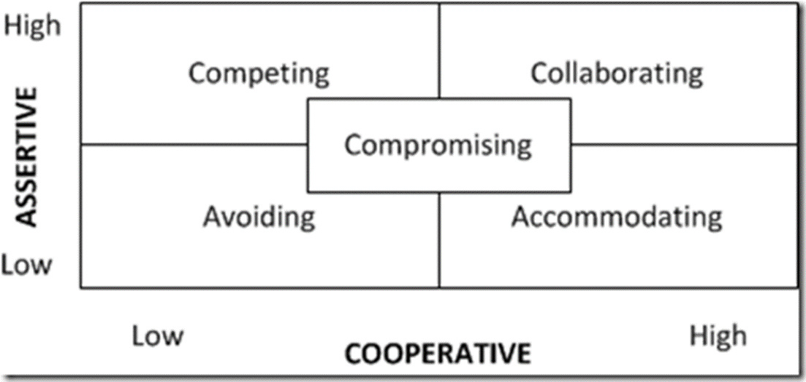
Five Styles of Conflict Management
You will experience some form of internal or external conflict while living with roommates at some point in your college career. Understanding how you handle conflict is important in helping you decide how to deal with stress and manage certain situations.

Slide 82
Cont’d
Accommodating: can be unassertive and very cooperative.
Give in during a conflict
Acknowledge they made a mistake/decide it was no big deal
Put relationships first, ignore issues, and try to keep peace at any price
Effective when the other person or party has a better plan or solution.
Avoiding conflict: are generally unassertive and uncooperative.
Avoid the conflict entirely or delay their response instead of voicing concerns
Can create some space in an emotional environment
Not a good long-term strategy

Slide 83
Cont’d
Collaborators are both assertive and cooperative.
Assert own views while also listening to other views and welcoming differences
Seek a “win-win” outcome
Identify underlying concerns of a conflict
Create room for multiple ideas
Requires time and effort from both parties
People who approach conflict in a competitive way assert themselves and do not cooperate while pursuing their own concerns at another’s expense.

Slide 84
Cont’d
Takes on a “win-lose” approach where one person wins and one person loses
Does not rely on cooperation with the other party to reach outcome
May be appropriate for emergencies when time is important
Compromisers are moderately assertive and moderately cooperative.
Try to find fast, mutually acceptable solutions to conflicts that partially satisfy both parties
Results in a “lose-lose” approach
Appropriate temporary solution
Considered an easy way out when you need more time to collaborate to find a better solution

Slide 85
Disciplinary Procedures
The organisation’s disciplinary procedures are designed to support and encourage all employees to achieve and maintain the required standards of conduct, attendance and job performance
Procedure:
Informal Process: The Line Manager/Supervisor deal with minor problems in the first instance through informal discussion in order to avoid the need to implement the formal procedure. Where informal action fails or the matter is more serious, the Formal Process may be utilised.
Formal Process: Discussion…

Slide 86
Negotiation
Negotiation takes place when two or more people, with differing views, come together to attempt to reach agreement on an issue. It is persuasive communication or bargaining.
“Negotiation is about getting the best possible deal in the best possible way”
Types of negotiation
Distributive (win-lose)
Integrative (win-win)
Benefits of win-win …

Slide 87
Termination
Termination refers to any condition where the employment relationship between the employer and the employee is annulled.
Resignation
Redundancy
Retirement, and
Dismissal with cause
Termination as a result of the disciplinary process - If the unsatisfactory behaviour continues after two written warnings, termination may be necessary. The employee will be well aware of the likelihood of this consequence.

Slide 88
Redundancy
Redundancy: This occurs when a particular job is no longer required at the practice or less people are needed to perform the amount of work available.
Abandonment of employment, occurs when an employee fails to attend his/her place of employment for three days or more without having prior authorisation for the absence and has not contacted the employer to explain the reason for the absence.

Slide 89
Employment relations outcome

Slide 90
Employee Performance
Performance is the process whereby an organization establishes the parameters within which programmes, investments, and acquisitions are reaching the desired results (Jones, 2000).
Performance is a multicomponent concept and on the fundamental level one can distinguish the process aspect of performance, that is, behavioral engagements from an expected outcome (Borman, & Motowidlo, 1993; Campbell et al., 1993; Roe, 1999).
  The behavior over here denotes the action people exhibit to accomplish a work, whereas the outcome aspect states about the consequence of individual’s job behavior (Campbell, 1990).

Slide 91
Objective of Performance measurement
Behn (2003) gives eight reasons for measuring performance;
To:
Evaluate
Control,
Budget,
Motivate,
Celebrate,
Promote,
Learn
Performance measurement enables organizations to assess their progress and identify strengths and problem areas

Slide 92
Occupational health and safety
Elimination or minimization of damage or harm to people in the workplace, their working tools, equipment, materials, products, etc., and their living and working environment.
Safety — acute injuries/events
Health — chronic exposures over time
Each Employer:
Shall furnish each of his employees, both employment and a place of employment which are free from recognized hazards that are causing or likely to cause death or serious physical harm..
Each Employee:
Each employee shall comply with occupational safety and health standards and all rules, regulations applicable to his own actions and conduct.

Slide 93

Cont’d
The success of health and safety management at the work place requires strong management commitment, and collaboration among safety and health professionals, employees and their associations/organisations, and management.
Government institutions/agencies assigned with the responsibility of ensuring health and safety at the workplace need to be empowered to enforce policies and guidelines for accident prevention at the workplace to the letter.
Improving safety performance at the workplace requires senior management unambiguous commitment to provide safe and healthy work environment to their employees.

Slide 94
Cont’d
It is the responsibility of management to eliminate, reduce or control hazards at the workplace and put measures in place to mitigate effects of harm if they occur.
Management needs to assess a work site and identify existing or potential hazards, and prepare a written and dated hazard assessment.
There is the need for periodic review of hazard assessments when changes occur to the task, equipment or work environment.
Safety performance will be high if management takes steps to involve workers in the hazard assessment and control process, and ensure that workers and contractors are informed of the hazards and the methods used to eliminate or control them (Government of Alberta, 2011).

Slide 95

Cont’d
Individual employees also need to take reasonable care to protect the health and safety of themselves and other workers, as required by the Labour Act, 2003, and cooperate with their employer to protect the health and safety of themselves and other workers.

Slide 96
Cont’d
Major types of workplace hazards located in the occupational safety and health literature are presented below:
Safety hazards: These are the most common and will be present in most workplaces at one time or another. Safety hazards include unsafe conditions that can cause injury, illness and death.
Biological hazards: This type of hazards is associated with working with animals, people, or infectious plant materials. The type of things that might give rise to biological hazards include Blood, body fluids etc.
Ergonomic hazards occur when the type of work, body positions and working conditions put strain on the worker’s body.

Slide 97
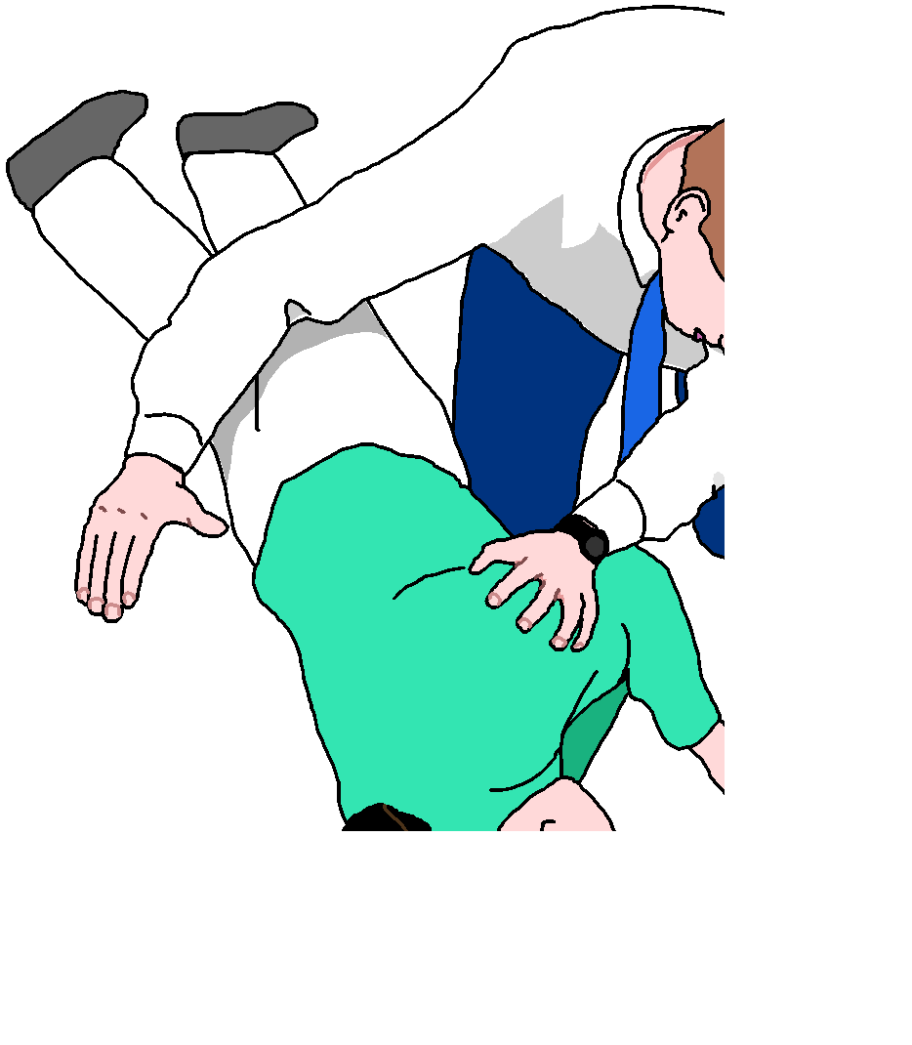

Cont’d
Chemical hazards are present when a worker is exposed to any chemical preparation in the workplace in any form (solid, liquid or gas).

Slide 98
Summary
At the center of Contemporary employment relations are many different dimensions of relationship.
We have noted that it is a relationship between employee and employer of labour capacity,is therefore an economic exchange.
We have also noted that the relationship is contractual and that it has both a psychological and legal dimension to it; both a legally enforceable and a psychological contract.
The relationship tends to be relatively continuous and has power and authority dimensions with the employee agreeing to an element of subordination to the authority of the employer, and in this context it is also an asymmetrical relationship since the employer has the greater power.

Slide 99
Cont’d
It is also a relationship that is secured through different modes and forms of involvement and attachment, ranging from moral involvement, compliance to commitment as the base for the ongoing attachment.

Slide 100


The end

